Slide 1

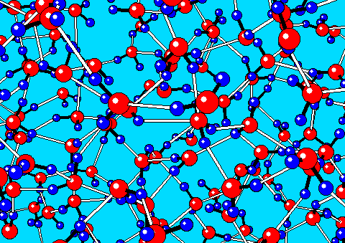
Area of Research: Using Direct Relation Graph and Depth First Search to Reduce Chemical Kinetic Mechanisms on a Parallel Linux Cluster
By Max Plomer
Research guided by: Prof. Tianfeng Lu

Slide 2
Research Tasks
Analyze and improve the Matlab, C & Fortran versions of DRG
Write programs to test the DRG/DFS method
Apply DRG in the reduction of practical fuels, e.g. biodiesel

Slide 3
What is a Direct Relation Graph?
A process for eliminating unimportant species in a mechanism
Based on the error, r_{AB}, caused in the production rate of a species A when removing a species B.
C_{i} = Stoich coefficient
W_{i} = Reaction rate
Z_{i} = 1 if B is in reaction i (else: 0)
r_{AB} > ε denoted as: A→B

Slide 4
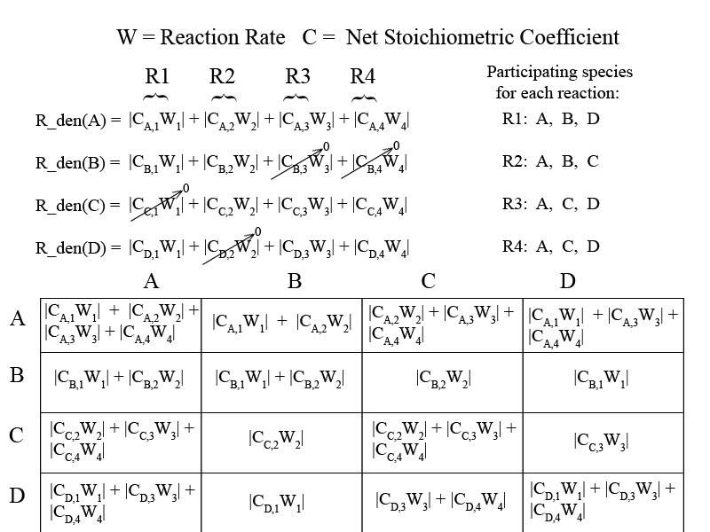

Slide 5
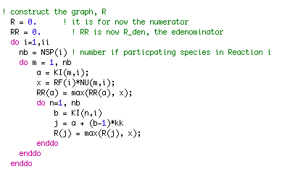
DRG code in Fortran 90
Isomer version

Slide 6
Conclusions about DRG in Matlab, C, Fortran. Why use f90 on Linux cluster?
Fortran is preferred in implementing the DRG algorithm
Simple in allocating memory
Has built in support for array operations
Fast in execution
C is flexible in implementing parallel computation, if not using MPI
The new DRG program is implemented with mixed-language programming with C and Fortran

Slide 7
Avoiding division by zero
In the DRG creation process, it is possible that a division by zero could occur
To avoid this: In Matlab the eps(X) fucntion, and in fortran the tiny(X) function is used to avoid division by zero, but also to minimize error.
Tiny is the smallest computational number is the model of the type X (model being single, double precision binary floating point)
Eps shape of graph (show graph), only depends on the first digit
Tiny is much faster than eps, because not computing anything, just a defined number

Slide 8
What is Revised Depth First Search?
A recursive approach to search a DRG in linear time
First sort values from largest to smallest
Mark the starting species, set starting species error as 1
Go through all edges, A→B
If A is marked and B is not marked: make threshold = edge value, Run DFS of B
DFS(B): Mark B, Set B’s error as threshold, Go through all edges, B→C, if C is not marked and edge B→C is greater than threshold: Run DFS of C

Slide 9
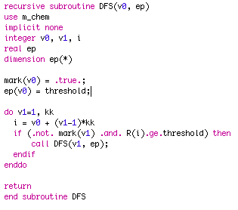
Fortran 90 code of DFS function for truncated edge values
For truncated values, without truncating can use just greater than
Will run DFS on all edges not marked and greater than threshold (edge value used when DFS initially called)
To avoid global variables, ep is passed to DFS function

Slide 10
Change in DFS due to Truncation
Without truncating it is extremely unlikely that two float edge values will be identical.
The bucketsort algorithm sorts to 4 decimal places, we had to truncate to make the list in order, but results in equal values in a single bucket.
In the recursive section DFS calls itself, only if the edge is greater than the threshold. Therefore had to ‘greater than’ to ‘greater or equal to’.
When truncating and only using ‘greater than’ the importance of certain species becomes lower, this is an error due to the truncation.

Slide 11
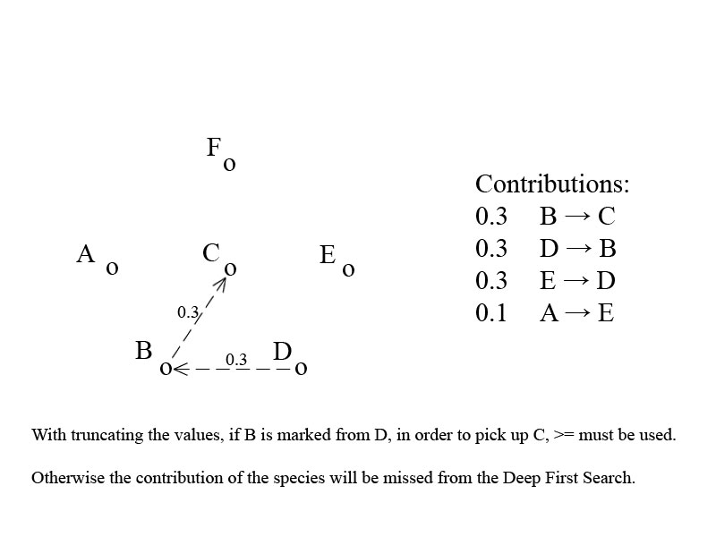

Slide 12
Fortran advantages over c
C’s Disadvantages
C is not a numerical computing language (variable-dimension array arguments, operations on arrays, extensions for parallel programming: all standard for .f90)
Gcc compiler would allow variable dimension array arguments in a C function, but global arrays could not be dynamically allocated
C is mainly for system programming, not numerical computations
Fortran’s Advantages
Scientifically oriented
Better optimized code
A lot of existing code
Easier to learn
More efficient mathematics
Easier to use and more robust
Better diagnostics

Slide 13
Bucketsort sorting algorithm
The Bucketsort algorithm works by separating elements of a list in a certain order, into a number of buckets
If number A is from a list all between 0 and 1, and n is the number of buckets. A goes into bucket: floor[A*(n-1)] + 1
Insert sort is a comparison sort
Compared to insert sort, Bucketsort can be expected to run linearly to the number of elements (Running time of O(n+M)), but insert sort can had a quadratic running time (i.e., O(n²))

Slide 14
Link list of 3 values in same bucket
Buckets Next
1
2 1
3 2
4 3
5
6
7
8
9
10
Sorting: { 4, 4, 4 }

Slide 15
Isomers
The basic DRG/DFS process is quite simple with a simple mechanism, but when the chemistry becomes complicated finding the important species can become difficult
Isomers being the same mole form, but different structure, tend to have many edges that are equivalently small, with too many similar values: r_{ab} doesn’t work
If the are all the same flux, then all will have low values
Taking the maximum value instead of sum (in the equation for r_{ab}) allows the small differences in edge values to be exploited.

Slide 16
Isomer Relations
Other species dependence on A
A’s dependence on other
Species
Species: A
If the importance of each species that A is dependent on is equivalently small, then the maximum value must be taken in the creation of the Direct Relation Graph. Instead of sum in the r_{AB} equation, you use the maximum of the list of values.

Slide 17
Why do Isomers have such similar relative importance, but not identical?
They have same composition and therefore molecular weight.
Same temperature, gives the same velocity.
Difference comes from transport diffusivity and molecular pathways, which effect reaction rate and species of the mechanism
Diffusivity increases with more branching and the specific position of groups in the isomer
Molecular pathways change based on the branching structure, which will tend to make radical atoms in different positions for different isomers.

Slide 18
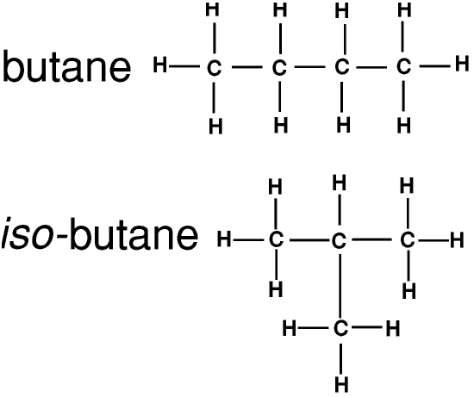
Example of different molecular pathways for butane isomers
C ––– C ––– C ––– C
X
C* *C ––– C ––– C
C ––– C ––– C
X
C* C ––– *C ––– C
–––
C
X = Bond break, * = Radical atom

